Slide 1
THE
REPRODUCTIVE
SYSTEM

Slide 2
GROWTH, DEVELOPMENT AND REPRODUCTION.
What is growth?
This is the increase in size of an organism.
What is development?
Development is an increase in maturity of an organism.

Slide 3
What is reproduction?
Reproduction is the way by which organisms give rise to young ones of their own kind.
Reproduction involves [in human beings] both the female and male reproductive cells.
Types of reproduction.
1. Asexual reproduction.
2. Sexual reproduction.

Slide 4
What is asexual production?
This is the type of reproduction where no reproductive gametes [cells] are used to produce young ones.
Examples of asexual reproduction.
1. Vegetative propagation in plants. e.g. grafting, layering, budding, stem cutting.
2. Binary fission in single celled animals e.g. Amoeba, bacteria.

Slide 5
What is sexual reproduction?
This is the type of reproduction which involves the joining together of the male and female gametes.
The reproductive cells are called gametes.
The joining or union of the male and female gamete is called fertilization.
The male reproductive cells are called sperms.
The female reproductive cells are called ova.

Slide 6
The male reproductive cells are produced in the testes (testicles).
The female reproductive cells are produced by the ovaries.
Reproduction becomes possible when animals become mature and mate.
Hermaphrodites are animals that have both male and female reproductive organs on themselves.
Examples
Earthworms
Snail

Slide 7
Puberty and adolescence.
What is adolescence?
This is a stage of development between childhood and adulthood.
It begins around 14 to 16 years in boys and 12 years in girls.
During this stage boys and girls;
desire to be independent of adults.
want to think for themselves.
make their own decisions and explore new experiences in life.

Slide 8
Adolescence usually ends at 21 years.
A boy or a girl at this stage is called an adolescent.
An adolescent is a person growing up from childhood to adulthood.

Slide 9
What is puberty?
This is a period of sexual maturity of the reproductive organs.
At this stage a boy or a girl is sexually active and can have a baby but not yet ready.
Changes at puberty for males and females.
Changes which occur to the body to show sexual maturity are called sexual characteristics.

Slide 10
Sexual characteristics include;
1. Primary sex characteristics
2. Secondary sex characteristics
3. Psychological and emotional changes
4. Out of step changes

Slide 11
Primary sex characteristics.
What are primary sex characteristics?
These are changes that prepare the sexual organs for their function of reproduction.
Primary sex characteristics in boys.
Enlargement of the testes.
Enlargement of the penis.
Production of sperms. (This is noticed through wet dreams).

Slide 12
Primary sex characteristics in girls.
The uterus develops and thickens.
The ovaries develop to produce the ova (ovulation starts).
Menstruation begins.
Ovulation is the monthly release of a mature ovum from the ovary.
Menstruation is the monthly flow of blood from the uterus through the vagina.
Menstruation takes place between 11 and 45years.
This periodic out flow of blood is commonly known as menstrual cycle.
Menstruation lasts for about 2-4days and re-occurs every after 28-30days incase fertilization has not taken place.

Slide 13
Secondary sex characteristics.
These are changes which are related to the development of physical body features that distinguish a grown up man from a boy and a grown up woman from a girl.
Secondary characteristics in boys.
Deepening of the voice.
Growth of hair in armpits, and pubes, and beards on the face.
The sweat glands become more active.
The body becomes more muscular.
Pimples develop in the face.

Slide 14
In males, the testis produce a male hormone called testosterone that promotes the development of secondary sex characteristics.
Secondary sex characteristics in girls.
Ovaries produce oestrogen hormones responsible for development of secondary sex characteristics in girls and progesterone which promotes further lining of the uterus and stimulates the mammary glands.

Slide 15
These characteristics include: -
Enlargement of the hips.
Development and enlargement of the breasts.
Growth of hair under armpits and on pubes.
The sweat glands become more active.
The voice becomes softer and attractive.
Pimples develop on the face.

Slide 16
Exercise:
Briefly state the role of each of the following hormones.
testosterone
oestrogen
progesterone
2. How is puberty different from adolescence?
3. Identify any two examples of the physical sex characteristics common to both boys and girls.
4. Which female hormone stimulates production of breast milk?
5. Identify any two primary sex characteristics in boys and in girls.
6. Write two secondary sex characteristics in boys and in girls.
7. Give common secondary sex characteristics between boys and girls.
8. What leads to development of secondary sex characteristics?

Slide 17
Psychological and emotional changes:
These are changes that take place in the mind.
They are not seen and may not be realized by the adolescents.
These changes are generally the same in boys and girls.
These include;
Having more interest in members of the opposite sex.
Have increased sexual desire.
They become unnecessarily moody and unruly.

Slide 18
They develop great interest in their body.
Develop jealousy over opposite sex.
They begin demanding for more freedom and rebelling against their parents.
They want to look and be recognized as mature.
They join peer groups to discuss ways of keeping themselves free from rules of their parents.

Slide 19
Out of step changes.
These are changes that occur differently to every individual in the same age group.
They may occur before or after their expected time.
These include: -
Growing taller than friends in the same age group.
Growing fatter than girls or boys of the same age group.
Adolescents develop same fantasies and anxieties due to sexual maturation.

Slide 20
Problems of the Adolescents.
Conflicts between adolescents and their elders.
Never satisfied with the demands made by them.
Sexual conflicts due to high demand for experimenting with the forbidden by adolescents.
Developing some kind of anti-social behaviour like smoking, drug abuse, delinquency.
Gain forms of wishes, desires, anxiety and fantasies due to sexual maturation.
Delinquency refers to crimes committed by young people (children).

Slide 21
Exercise
Give a difference between adolescence and puberty.
In one sentence, explain why there are conflicts between adolescent children and their parents.
In which way is ovulation different from menstruation?
Briefly explain the term antisocial behaviour.
Give two common antisocial behaviours that adolescents develop.
What are psychological sex changes?

Slide 22
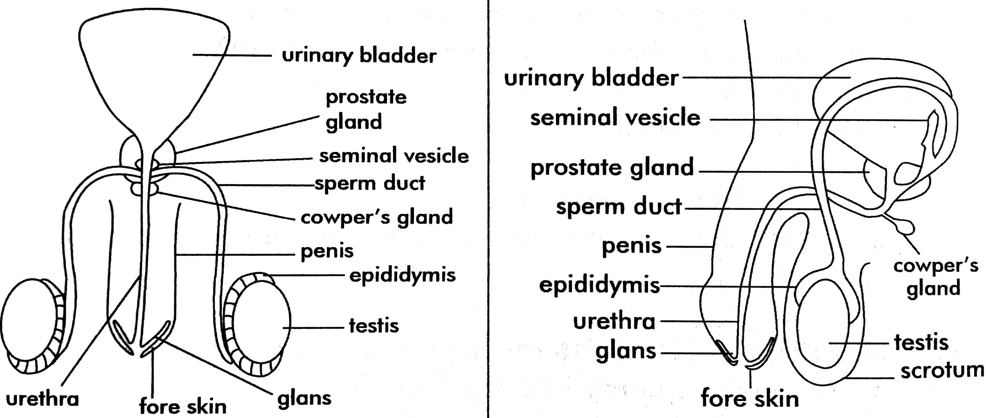
Human male reproductive organ.

Slide 23
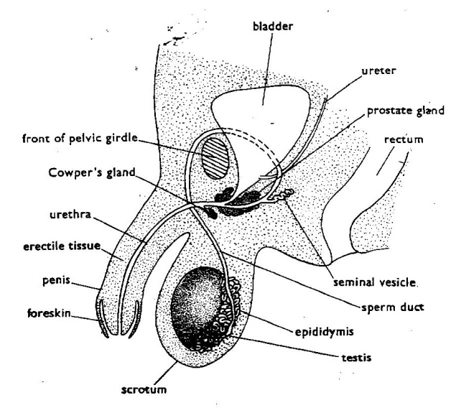
The male reproductive system.

Slide 24
Functions of parts of the male reproductive organ
The Scrotum.
It protects the testes from external harm.
It regulates the temperature around the testes.
Note:-
During hot days, the scrotum becomes loose and swings between the legs to keep the testes cool.
During the cold days, the scrotum shrinks and the testes are pushed inside the body where it is warm.
These movements prevent the sperm cells from being killed.

Slide 25
Testes.
They produce the male reproductive cells called sperms.
They produce a male hormone called testosterone which is responsible for: -
the development of secondary sex characteristics in males.
increasing the sexual desire.
Epididymis
It stores the manufactured sperms.
Urinary bladder.
It stores urine in the body.
Sperm ducts
These carry away the sperms from each testis.

Slide 26
Prostate gland and seminal vesicles.
They produce seminal fluids which form semen.
Semen lubricates the urethra. This enables the sperms to swim.
Semen also nourishes (feeds) the sperm cells.
The seminal vesicles store the excess sperms.
Urethra
This is the passage for urine from the urinary bladder.
It is also a passage for semen and sperms from the seminal vesicles to the vagina during sexual intercourse (Copulation)

Slide 27
Penis
It is a muscle with a lot of blood vessels.
The penis passes sperms into the vagina during sexual intercourse.
It is also used to pass out urine.
Fore skin.
Covers the head of the penis (glans)
The most sensitive part of the penis is called the glans found at the tip of the penis.
The foreskin can be cut off (circumcised) for hygienic reasons.

Slide 28
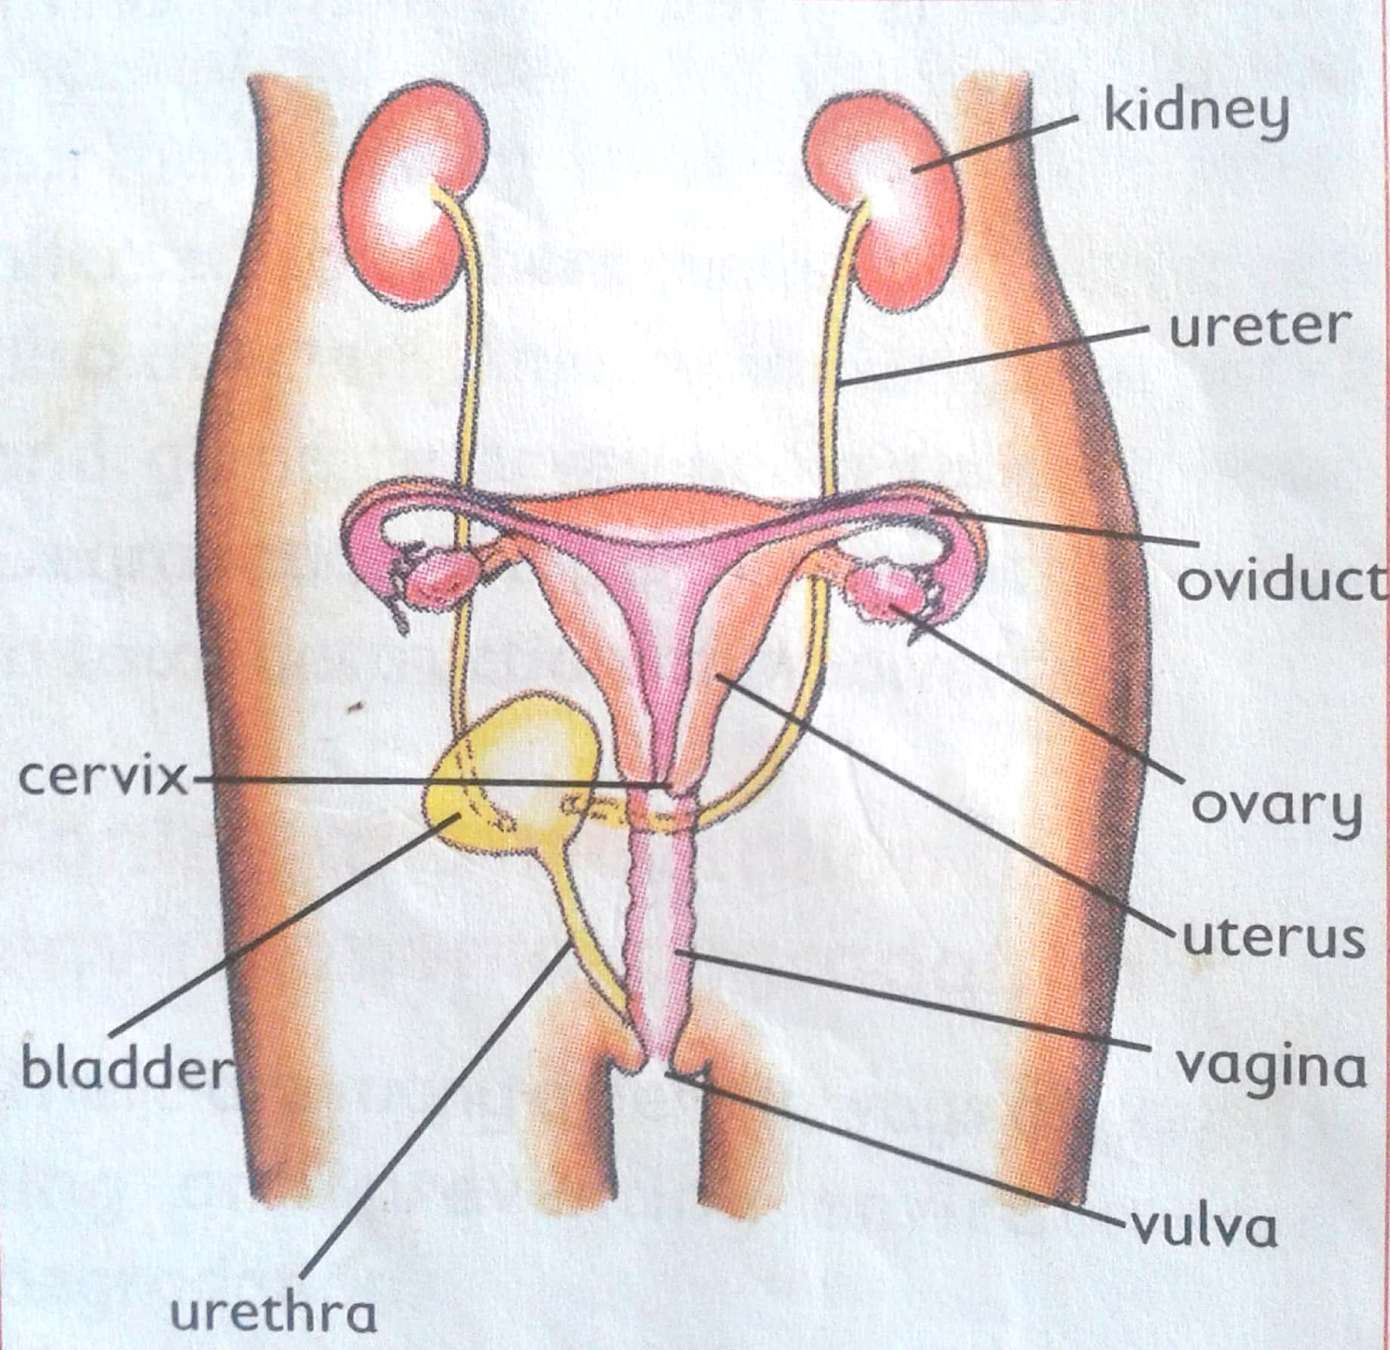
The female reproductive system.

Slide 29
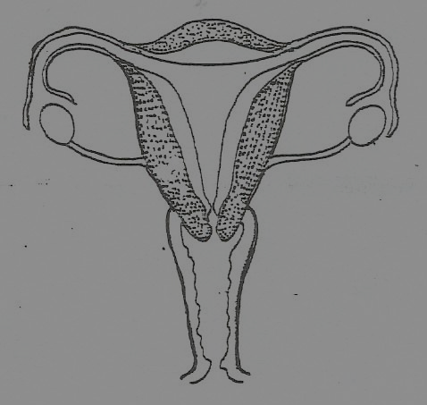
placenta
Oviduct / fallopian tube
Oviduct funnel
Uterus wall
ovary
cervix
Uterus / womb
vagina
vulva

Slide 30
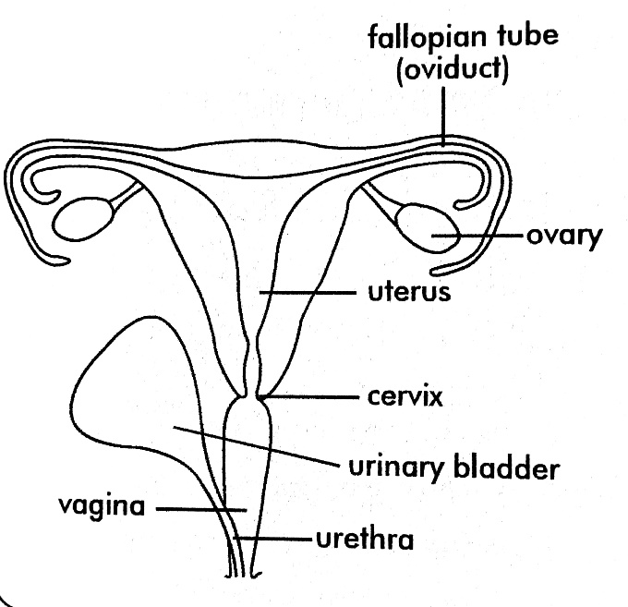

Slide 31
Functions of the parts.
Ovary:
They produce the ova (eggs) every month.
They produce the female hormones called Oestrogen and progesterone. These hormones bring about the secondary sexual changes.
Ovulation is the process by which the ovaries release the ova [egg].
A hormone is a substance produced in the body to control an action of body cells.

Slide 32
Oviduct (Fallopian tubes)
This is where fertilization takes place.
Uterus (womb)
This is where implantation takes place.
This is where the baby develops from until birth.
Implantation means the development of the foetus in the uterus.

Slide 33
Cervix.
It closes the uterus during pregnancy.
It separates the uterus from the vagina.
Vagina (birth canal)
This is where sperms are deposited on the way to the uterus.
It allows the baby to pass through at the time of birth.
It produces the vaginal fluids which lubricates the passage.

Slide 34
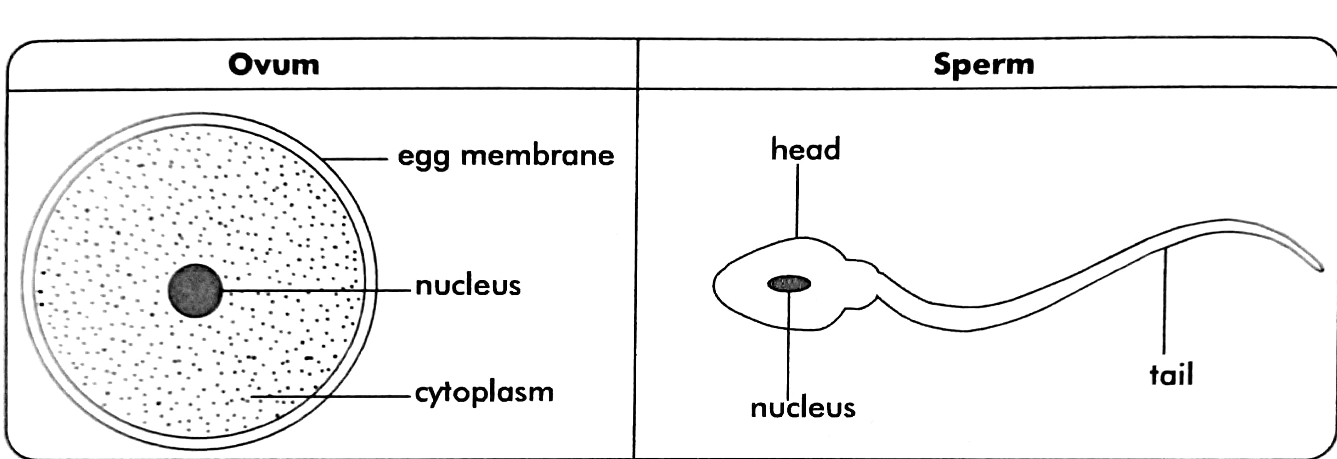
Structure of the ovum and sperm cell
The tail enables the sperm cell to swim to the oviduct.

Slide 35
Keeping the reproductive organs health.
Keeping them clean through regular bathing.
Drying the organs with a clean towel after bathing.
Each under pant should be washed every time they are used and worn when they are dry.
When infected with STDs seek medical treatment.
Avoiding games and activities that may cause injury to the reproductive organs.
Regular checkups and treatment of infections.
Boys avoid wearing tight underwear.
Avoid sharing body towels.
Always shave the long pubic hair.

Slide 36
NOTE;
Good life styles should be observed to prevent infections of STDs / STIs.
For example: -
Young girls and boys should abstain from sex until they are married.
Married people should be faithful to their partners.

Slide 37
Exercise
1. Briefly explain the term reproduction.
2.Identify the type of reproduction in human beings.
3.What name is given to the:
Male gametes?
Female gametes?
4.Where does fertilization take place in humans?
5. Mention two liquid substances carried through the urethra.

Slide 38
Fertilisation, conception and pregnancy.
FERTILISATION
What is fertilisation?
Fertilisation is the union of male and female gametes to form a zygote.
Types of fertilisation
Internal fertilisation
External fertilisation

Slide 39
Where does fertilization take place in mammals?
Fertilization takes place in the oviduct / fallopian tubes.
The fertilized ovum forms a zygote which grows into an embryo.
After fertilization, the zygote moves from the oviduct to the uterus.
In the uterus the zygote attaches itself to uterus wall and develops into foetus (implantation).
Later after 2 weeks the developing baby is called a foetus.
The period from fertilization to birth is called gestation period and it is 9 months.
In humans, it is called pregnancy.

Slide 40
Conception:
Conception is the period when a female animal becomes pregnant.
Ovulation is the monthly release of a mature ovum from the ovary to the fallopian tube ready for fertilisation.
Implantation
Implantation is the process by which a zygote attaches itself on the uterus walls.

Slide 41
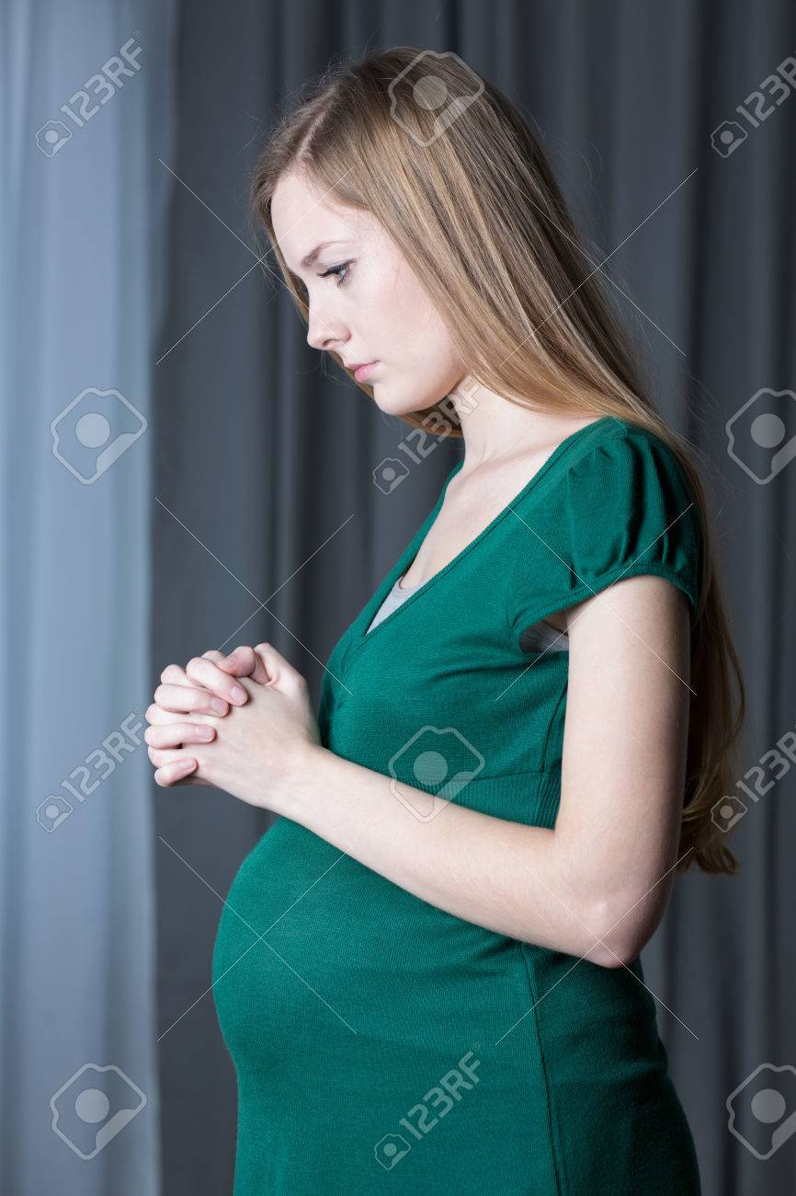
Pregnancy is the period in humans between fertilisation and birth.

Slide 42
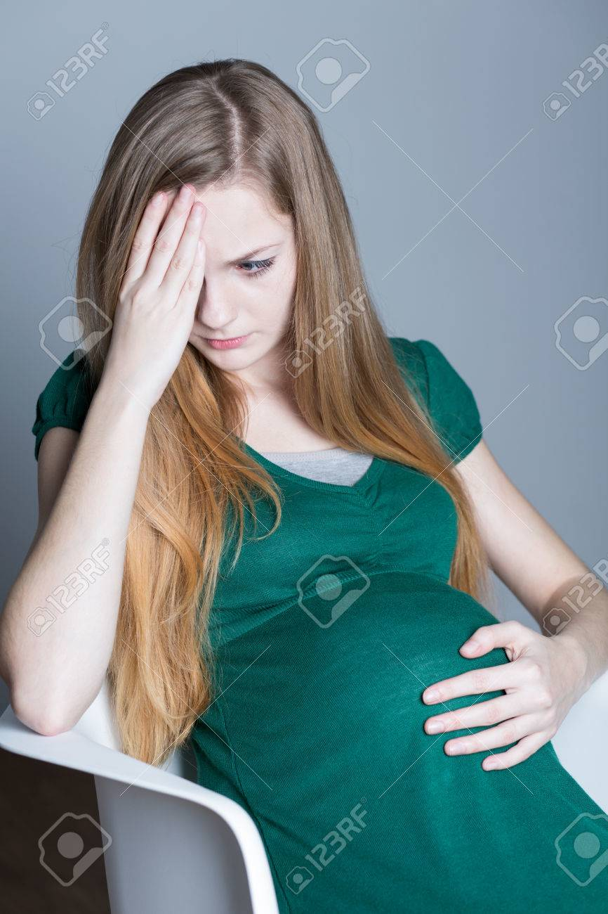
Signs of pregnancy
Menstruation stops.
Breasts grow bigger.
Abdomen enlarges until the baby is born.
Some women experience morning sickness (nausea) especially during the first three months.
Women pass out urine frequently than usual.
A woman may at times lose appetite for food.
Some vomit after eating something.

Slide 43
Signs of pregnancy
Menstruation stops.
Breasts grow bigger.
Abdomen enlarges until the baby is born.
Some women experience morning sickness (nausea) especially during the first three months.
Women pass out urine frequently than usual.
A woman may at times lose appetite for food.
Some vomit after eating something.

Slide 44
Order of events
1. Ovulation
2. Mating
3. Fertilisation
4. Conception
5. Implantation
6. Birth

Slide 45
Requirements for a pregnant woman
1. Ante-natal care.
2. Good nutrition / balanced diet.
a. Carbohydrates to get energy.
b. Proteins to build the body of the developing foetus and repair worn out body cells /tissues.
c. Vitamins to protect the mother’s body and that of the unborn baby.
d. Mineral salts such as
Iron to build haemoglobin in the body of the mother and that of the unborn baby.
Calcium to build strong bones and teeth.

Slide 46
Phosphorus to build the bones and teeth.
It also helps in the proper function of body cells.
3. Regular body exercises.
4. Enough rest and sleep.
5. Good personal hygiene.
6. Appropriate clothing.

Slide 47
Problems during pregnancy.
Nausea
Heart burn
Constipation
Backache
Itching skin
Anaemia

Slide 48
Signs of dangers during pregnancy.
The following signs during pregnancy mean that the woman needs immediate attention from a qualified health worker.
Excessive and frequent vomiting.
Difficulty in seeing.
Bleeding of coloured discharge from the vagina.
Severe tiredness or weakness.
Prolonged Anaemia.
Severely painful abdomen.
Severe swelling of legs, face and hands.
Severe headache.

Slide 49
BIRTH
Birth is the act of producing young ones in human beings.
How to prepare for birth:
Buying new clothing.
Buying new clean bedding.
Buying new sterilized delivery equipment.

Slide 50
Needs for the pregnant woman during delivery
Mat
Cloth for delivery
Money for transport
Water and food
Towel
Responsibilities of family members to a pregnant mother
Giving her health care.
Giving her psychological support.
Relieving her of house work and farming activities.

Slide 51
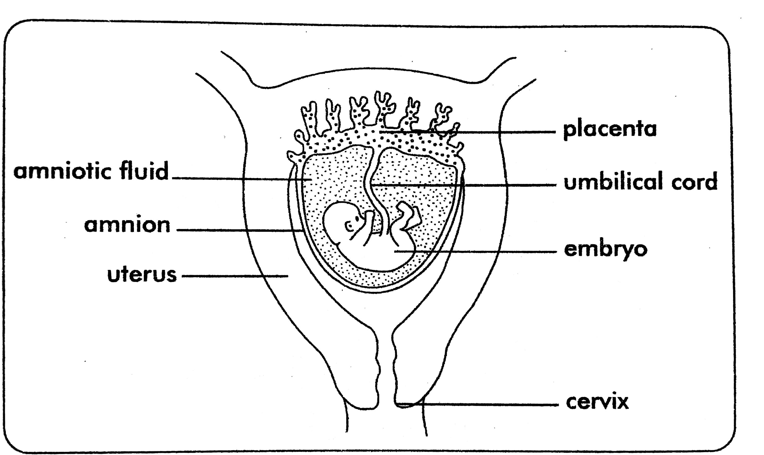
HUMAN FOETUS IN THE UTERUS

Slide 52
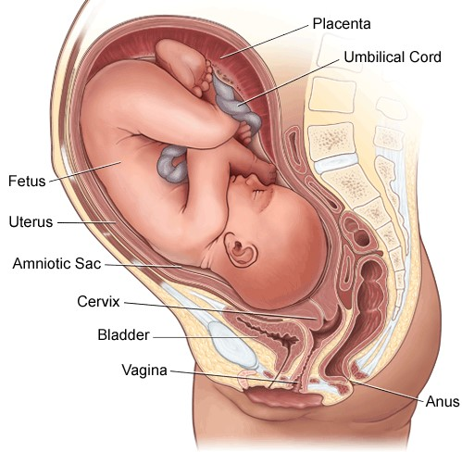
HUMAN FOETUS IN THE UTERUS

Slide 53
Functions of the parts
Umbilical cord:
It transports food to the foetus and waste products from the foetus.
It has an artery that transports food and oxygenated blood and a vein that transports waste products and deoxygenated blood from the embryo to the placenta.

Slide 54
Placenta.
Attaches the embryo to the walls of the uterus.
Prevents the mother’s blood from mixing with that of the embryo.
Stores waste products from the embryo until they diffuse through to the mother’s blood.
Stores food and oxygen until they are taken by the embryo.
It supplies food and oxygen to the embryo.
Amniotic fluids.
Protects the embryo from pressure acting on it on all sides.
Amniotic sac.
This is a sac for keeping the amniotic fluid and the embryo.
Cervix.
Separates the uterus from the vagina and closes the Uterus during pregnancy.

Slide 55
Activity:
Write one sentence to show the meaning of the following;
Fertilisation.
Implantation.
2. Give any one sign that shows that a woman is pregnant.
3. Briefly explain why you would advise a pregnant woman to go for ante-natal care.
4. Point out any one sign of danger during pregnancy.
5. State the function of the umbilical cord to the foetus.
6.How does the foetus benefit from the placenta?
7. Name the fluid that protects the developing foetus from external pressure.

Slide 56
Sex determination
The sex of a child is determined by sex chromosomes contained in the sperms and ova.
Types of chromosomes
X type
Y type
All ova produced by women carry only type X chromosome.
Men produce sperms of both X and Y type chromosomes.
When an ovum (X type) is fertilized by a sperm of X, the baby will be a girl.

Slide 57
When an ovum (X type) is fertilized by a sperm of Y type – the baby will be a boy.
N.B The cells that determine whether a baby will be a boy or a girl come from a man.
XX -- results into a girl
XY -- results into a boy

Slide 58
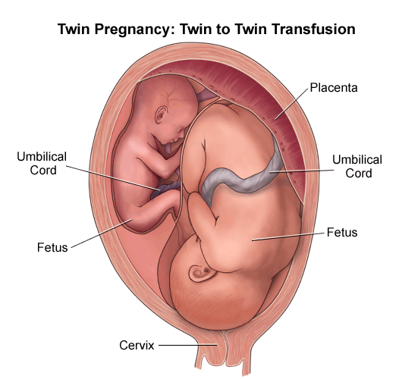
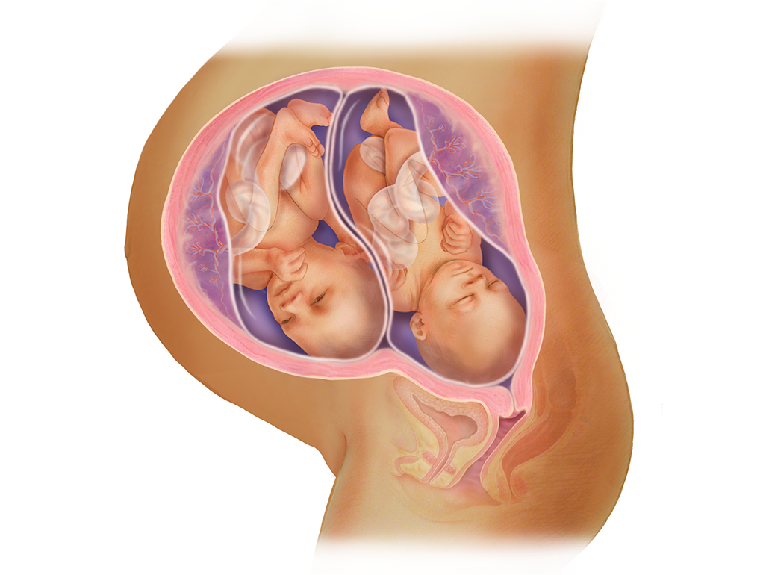
Twins.
These are two babies born by the same mother at the same time.

Slide 59
Types of twins.
Fraternal twins
Identical twins
Siamese twins
Identical twins:
This is when one fertilized ovum divides normally and grows into two separate babies.
They are usually of the same sex and their physical features are the same.

Slide 60
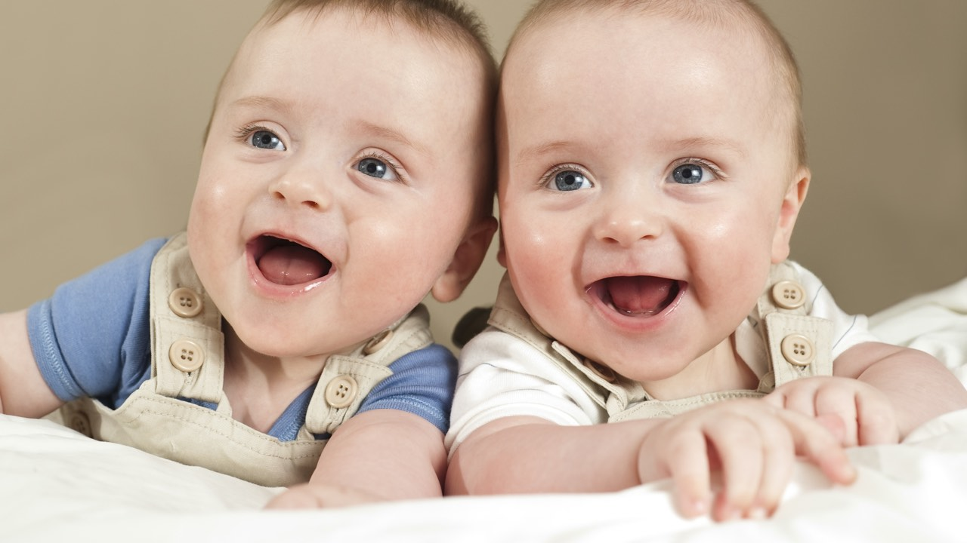
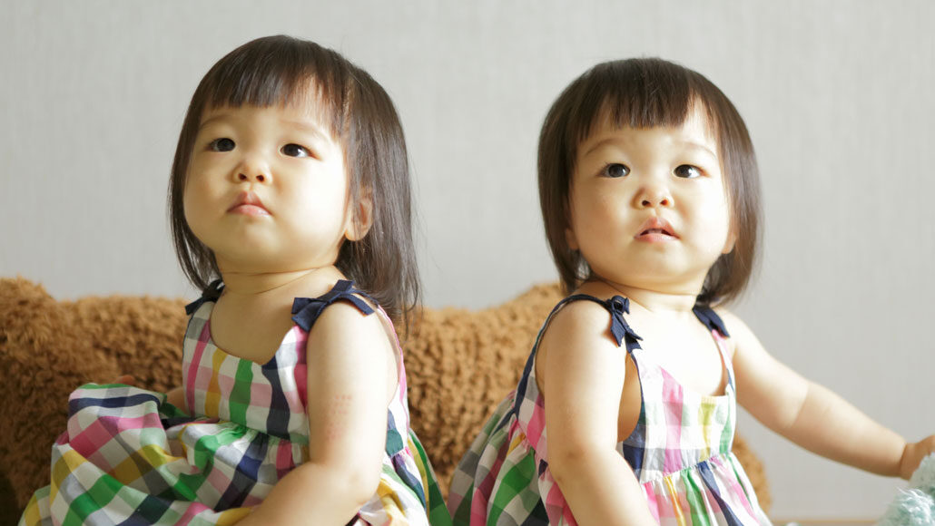

Identical twins:

Slide 61
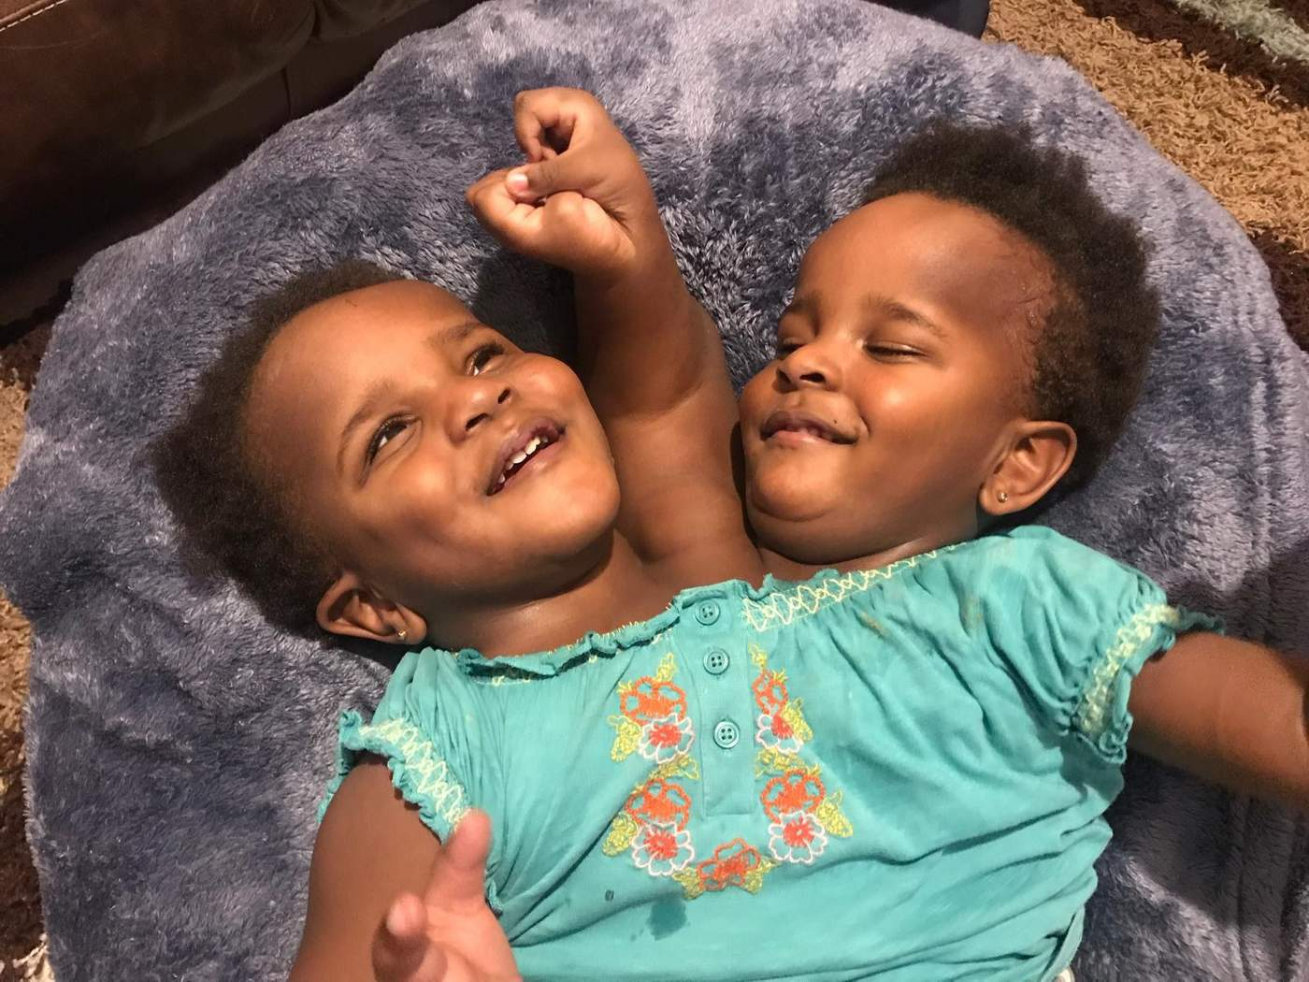
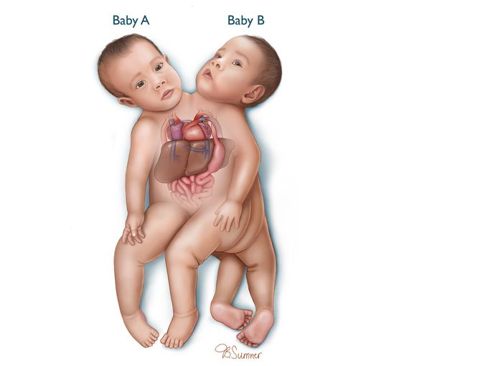
Siamese twins.
These twins whose body remains joining.

Slide 62
Fraternal twins.
This is when two ova are released and fertilized to develop into the embryo.
They are not always of the same sex.
What is a multiple birth?
This is when two or more babies are born at the same time.
Examples
Triplets
Quadruplets

Slide 63
EXERCISE
What does the term gestation period mean?
What is the gestation period of a pregnant woman?
Why does the baby cry immediately it is born?
Give any two secondary sex characteristics common to both boys and girls.
State the main reason why organisms reproduce.
State any one similarity between reptiles and Amphibians in terms of reproduction.
Give any one type of fertilization.

Slide 64
8. State any one organism that undergoes the above mentioned type of fertilisation.
9. Where do the following take place during pregnancy.
a). implantation……………………….
b). conception…………………………
c). fertilization……………………………
10. State the general name given to the reproductive cells.
11. How are the sperms in human beings similar to pollen grains in plants?

Slide 65
12. What type of fertilization do humans undergo?
13. How are the ova different from the sperms?
14. How are the testis similar to the anther heads?
15. Where does fertilisation take place in humans?
16. How are humans and cows similar in fertilization?

Slide 66
Teenage pregnancy.
This is a type of pregnancy that takes place below the age of adulthood.
Causes of teenage pregnancy
Peer influence
Rape
Poverty
Forced marriage
Early sex
Drug abuse

Slide 67
Effects or dangers of teenage pregnancy.
It leads to school drop outs.
May lead to death of a baby due to lack of enough care.
It may lead to the death of the expectant mother due to attempted abortion.(maternal mortality rate)
The young mother may experience obstructed labour.
It may lead to still birth.

Slide 68
Note:
Obstructed labour may cause severe damage to the uterus and the pelvis.
The best solution is to undergo surgical operation.
The newly born baby may get brain damage due to obstructed labour.
Leads to forced marriage.
Leads to low birth weight babies.
Contraction of STDs/ STIs.

Slide 69
Effects of teenage pregnancy to the boy.
Dropping out of school.
Getting STDs/ STIs.
Being imprisoned or mistreated by the girl’s parents.
The boy can be forced to pay huge amount of money as fine.

Slide 70
How to control or prevent teenage pregnancy.
Abstain from early sex.
Avoid gifts, rewards from opposite sex that may result into sex as a pay back.
Avoid joining bad peer groups.
Accept advise, counselling and guidance from the teachers, parents, about your experience of a change on the body.

Slide 71
EXERCISE
1. State the collective name given to a boy or girl who produces a baby under the age of 18 years.
2. What are STDs?
3. Give two examples of diseases likely to be transmitted through playing unprotected sex with an infected person.
4. How best can a Primary school girl protect herself from teenage pregnancy?
5. Why are pregnant women regarded as vulnerable people?
6. Apart from the above list one other group of vulnerable people.
7. State three conditions under which a woman can be regarded vulnerable.
8. Give one example of a material carried by the umbilical cord.

Slide 72
Common diseases and disorders of the Human reproductive system.
Most diseases of the reproductive system are Sexually Transmitted Diseases [STDs]

Slide 73
Disease | Signs and Symptoms | Prevention, Control and Treatment.
Gonorrhoea Caused by a bacteria called Gonococci or Neisseria Gonorrhoea. | In males -discharge of pus from the penis. -swelling in the knee and in other joints of the body. -pain when passing out urine. -Difficulty in passing out urine. -Mild fever In females. -Blocked oviduct. -Menstrual problems develop. -A little pain when urinating -Lower abdominal pain. | -Having sex with one long life partner. -using condoms correctly. -Getting immediate treatment when an infection is noticed. Note: For pregnant mothers, Gonorrhea can infect the foetus eye causing blindness. -Gonorrhea can cause sterility if not treated early enough.

Slide 74
Syphilis -Spreads by contact between sexual organs. -Caused by bacteria. | -Painless sores appear on the penis or inside the vagina. -Sores in the throat and in the mouth. -Swollen body joints. -Swollen lymphatic nodes. -Painful rush on the body -Loss of hair on the head -Mild fever. -Abdominal pain. | -Have one faithful sexual partner. -Provide early treatment to the patients together with your partners.

Slide 75
Trichomoniasis | -Smelly discharge from the vagina. -Blood stained discharge. -Itching in the vagina. | -Keep the reproductive organs clean. -Get early treatment.

Slide 76
Candidiasis [Thrush] | -Itchy discharge with bad smell from the vagina. -Burning when urinating. | -Keep the reproductive organs clean. -Wash the vagina with warm water and vinegar or lemon juice in water.

Slide 77
Genital herpes [Viral] | -Small but very painful blisters on the private parts, anus and buttocks. | -Keep sexual organs clean. -Get treatment early enough.

Slide 78
Lymphogranuloma Venereum. Caused by a bacteria. | -In males, large dark swellings develop in the groin. -In females, painful sores in the anus. -Discharge from the anal sores. | -Avoid sex while sores or blisters present. -Wash hands frequently and avoid touching the sores. -The disease can spread to the eyes.

Slide 79
Genital warts Caused by a virus. | -A small hard brownish skin growth with rough surface appear on the penis scrotum, vagina or the anus. | -Apply the Vaseline on the wart. -Get treatment from a health worker.

Slide 80
Chancroid [Soft chancre] -caused by a bacteria. | -Pimples develop on the sexual organ. -Swelling around ulcerated area. -Swelling in lymph nodes around the groin. | -Provide early treatment with anti-biotics to the patient. -Have one faithful sexual partner. -Avoid involvement into premarital and extra marital sex.

Slide 81
Cancer of the cervix | Abnormal growth of the tumor on the cervix. | - Observing personal hygiene. - Avoid having many sexual partners. - Women over 20 years should always go for a test once a year.

Slide 82
Penis cancer | -Abnormal growth of tumor on the penis. | -Observing personal hygiene. -Seek medical help.
Acquired Immune Deficiency Syndrome [AIDS] Caused by HIV

Slide 83
HIV/AIDS
It is a sexually transmitted disease caused by a virus called Human Immunodeficiency Virus.
Write AIDS in full.
Acquired Immune Deficiency Syndrome.
What causes AIDS?
It is caused by a retro virus called
Human Immuno – deficiency Virus.

Slide 84
HIV destroys the immune system of a person making the person unable to fight against diseases.
Attacks and destroys the white blood cells leaving the body weak to defend itself from infections (making a person to lack immunity).
The diseases a person suffers from after his or her immunity has been weakened by HIV are called opportunistic infections.

Slide 85
Examples of opportunistic infections:
Malaria
Dysentery
Tuberculosis
Pneumonia

Slide 86
How is HIV / AIDS spread?
Through having unprotected sexual intercourse with an infected person.
Sharing sharp and piercing instruments.
Through some cultural practices such as circumcision, tattooing with infected people.
Through blood transfusion with infected blood.
From the mother to child at birth.
Through breast feeding and in the womb. [MTCT].

Slide 87
Forms of MTCT
During delivery
During breast feeding.
In the womb / uterus.

Slide 88
HIV / AIDS does not spread through the following.
Shaking hands.
Sharing a desk.
Swimming together.
Through insect bites.
Sharing cups, plates and spoons.
Sharing a seat.

Slide 89
Signs and symptoms of HIV / AIDS.
Prolonged dry cough.
Wide spread itching and skin rush.
Diarrhoea that lasts a long time.
Excessive loss of body weight.
Persistent fever.
General body weakness.
Loss of appetite.
A white coating develops in the mouth. This is called oral thrush.

Slide 90
Effects of HIV / AIDS to an individual.
Develop worries and fear.
Loss of immunity.
Loss of income [money]
Feel isolated and lonely.
Worsens other diseases such as tuberculosis.
It can lead to death.

Slide 91
Effects of HIV/AIDS to the family.
Leads to divorce.
Some children get infected with HIV / AIDS.
Children become orphans when parents die.
Reduction of labour force in the family.
Shortage of basic needs in case the provider dies.
Loss of family property
Leads to poverty in the family in terms of providing treatment.
It is tiresome to care for the patient.

Slide 92
Effects of HIV/AIDS to the community.
Loss of skilled man power.
Shortage of productive population.
Poverty in the community.
Increase in the number of orphans, widows and widowers.
Leads to imposition of travel restrictions to some countries.

Slide 93
Prevention and control of the spread of HIV / AIDS.
Abstain from sex.
Screening blood before transfusion.
Use sterilized sharp skin piercing instruments.
Avoid sharing sharp instruments with infected persons.
Have one faithful sexual partner.
Have protected sexual intercourse.
Educating people about HIV / AIDS.

Slide 94
Ways of caring for the AIDS patient.
Allowing them enough rest.
Provide good feeding to the patient (balanced diet).
Washing for them clothes and beddings.
Provide treatment for any particular disease that may be identified.
Counselling should be provided.

Slide 95
Note:
Testing and counselling services can be provided to HIV/AIDS patient from places like;
TASO centers in the country.
AIC centers in the country.
From major hospitals of health centers.
What is the best way of preventing sexually transmitted diseases?
Abstaining from sex.

Slide 96
Sexually Transmitted Diseases (STDs) can best be prevented by applying ABC method.
A stands for Abstain from sex until marriage.
B stands for Be faithful to your sexual partner.
C stands for use a Condom if you cannot avoid it.

Slide 97
Write the following in full.
a. ABC
b. TASO
c. AIC
e. PIASCY
f. VCT
g. ARVs
h. PMTCT
i. HIV
j. EMCT
k. MTCT

Slide 98
Exercise
1. a) What do understand by teenage pregnancy?
b) Suggest any two effects of teenage pregnancy to a P.6 girl child.
c) Give one way of safe guarding against teenage pregnancy among girls below the age of 18.
2. Write the following in full;
AIDS
HIV
TASO

Slide 99
3. What STD makes the newly born baby blind if not treated during the mother’s pregnancy?
4. State the best way of preventing sexually transmitted diseases.
5. Identify any one activity a p.6 child can do to help Kapere who is an AIDS patient.
6. What does ABC stand for in the prevention of the spread of AIDS?
7. Identify any two diseases of the human reproductive system.

Slide 100
Disorders of the Human Reproductive System

Slide 101
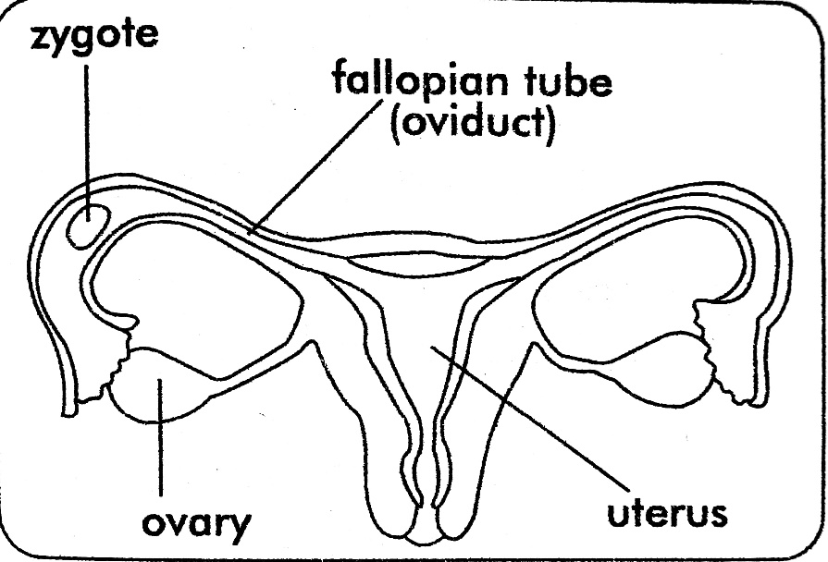
Disorders of the reproductive system
Sterility / barrenness
Hydrocele
Ectopic pregnancy
Erectile dysfunction

Slide 102
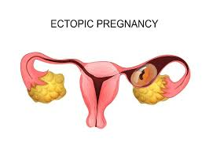
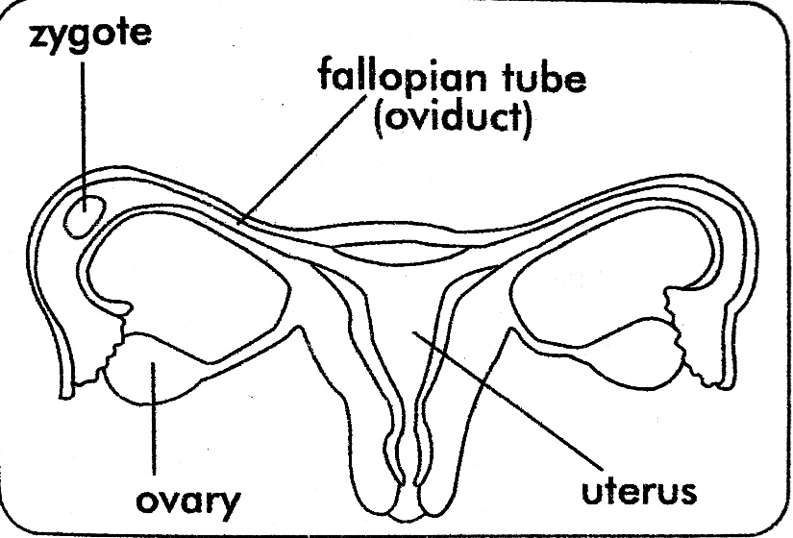
Disorder | Signs and Symptoms | Prevention, Control and Treatment.
Ectopic pregnancy | -Development of the embryo takes place in the oviduct instead of the uterus. -It is also referred to as out of pregnancy. You get: - Severe pain in the oviduct. Irregular bleeding from the vagina. | -Look for help from a health worker immediately.

Slide 103
Enlarged prostate | -Swollen prostate gland. -Difficult and painful passing out of urine. -Irregular passing out of urine. | -Seek medical checkup and treatment.

Slide 104
Other disorders include
Impotence.
Premenstrual syndrome.

Slide 105
Family planning and child spacing
What is family planning?
This is the use of birth control methods to determine when to have or not to have a child in a family.
Importance of family planning.
It enables parents to produce a child at a time they are ready.
Enables parents to produce the number of children they can manage to look after well.
It enables a child born to get enough care.
It prevents a woman from being worn out by child bearing.

Slide 106
What is child spacing?
This is the providing of enough time between the births of children in a family.
Advantages of child spacing.
It ensures a healthy start for each child.
It is healthier for a mother.
It enables parents to provide enough basic needs for their children.

Slide 107
Advantages of child spacing to the baby
The baby gets enough time to breast feed.
The baby gets enough care.
The baby gets enough food.
The grown up baby who is ready for education gets money for his / her education.
Advantages of child spacing to the mother
Prevents the mother from being worn out by child bearing.
Enables the mother to get enough time to care and show love to the child.
Enables the mother to save money for the child’s future needs.
Enables the mother to provide enough food to the baby.

Slide 108
Reasons why some parents have many children
Ignorance of family planning methods.
High infant mortality rate.
The myths of male strength.
The desire for another sex child.
For prestige, fame and security.

Slide 109
Problems of having many children.
Lack of enough food.
Poor education for children.
Lack of proper medical care.
Inadequate financial resources.
Mother’s sickness as a result of having too many children. e.g. miscarriages, maternal Anaemia, fatigue, low births.
High infant mortality rate.

Slide 110
How to avoid infant mortality rate / death.
Immunization against infant killer diseases.
Practice family planning.
Participating in health care services e.g. health education.

Slide 111
Myths and misconceptions about family planning.
Myths are things people believe in but are false.
Family planning increases fornication and adultery among people.
Europeans brought family planning methods to make Africans sterile.
If a woman uses birth control methods she may produce little or no breast milk.
Vasectomy is castration of men.
The whites want to reduce the population for Africans.
Birth control methods should be used by women not men.

Slide 112
Write FPAU in full.
FPAU has been replaced by RHU.
Write RHU in full
Reproductive Health Uganda.
The Reproductive Health Uganda (RHU)has made it possible for most people to learn about and have access to family planning services.
Functions of RHU in Uganda.
It educates people about family planning.
Provides people with family planning contraceptives.
Educates people about quality of life when children are few.
Helps in training Traditional Birth Attendants (TBAs/ TBDs).

Slide 113
Advantages of family planning.
Controls population growth.
It improves the health and well-being of the family.
It reduces cases of abortion and miscarriages.
It reduces cases of serious diseases and maternal death.

Slide 114
Methods of family planning / birth control.
These are practices that people use to prevent conception among women.
Natural methods.
Artificial methods.

Slide 115
Natural family planning methods.
Abstinence / abstaining from sex.
Coitus interruptus (withdrawal method)
During withdrawal method, sperms are released outside the woman’s vagina.
The rhythm (safe period)
Note: -Safe period are days in the menstrual cycle when fertilization cannot take place.
If the menstrual period runs from 1st to the 4th day of the month, the safe period falls between the 5th and 10th day.

Slide 116
Menstruation | Safe period | Fertile period | Safe period
1st – 4th day | 5th – 10th day | 11th – 17th day | 18th – Next menstruation

Slide 117
The fertile period may fall between the 11th and 17th day and another safe period may fall between the 18th day and the next menstrual period.
Prolonged breast feeding.
This delays the resumption of the monthly ovulation after birth.
Using calendar or moon beads.

Slide 118
Advantages of natural family planning methods.
They are cheap, easy and convenient to use.
They avoid any complications associated with artificial methods.
They encourage cooperation between husband and the wife.

Slide 119
Disadvantages of natural family planning methods.
They require complete cooperation of both the husband and wife.
Some require greater teaching and supervision time.
They are not as effective as the artificial methods.

Slide 120
ARTIFICIAL METHODS OF FAMILY PLANNING
These are mainly classified into;
Mechanical methods
Chemical methods
Surgical methods
They are provided by the Reproductive Health Uganda (RHU)

Slide 121
Artificial methods of family planning.
Using condoms
Using a diaphragm
Using the Intra-Uterine Device (IUD)
Using spermicides
Using birth control pills (Contraceptives)
Use of birth control injections.
Vasectomy
Tubal ligation.

Slide 122
Mechanical Method of Birth Control
Using Condoms
Using a diaphragm
Using IUDs
CHEMICAL METHODS OF BIRTH CONTROL
Using Spermicides
Use of Birth control pills (Oral Contraceptives)
Use of birth control injections
SURGICAL METHODS OF BIRTH CONTROL (PERMANENT METHOD)
Vasectomy
Tubal Ligation

Slide 123
Using condoms.
Advantages of using condoms.
1. They are effective when properly / correctly used.
2. They help to prevent getting STDs and pregnancy.

Slide 124
Disadvantages of using condoms.
They may be difficult to get due to lack of money.
Some women do not want to use them because of the fear that they can remain in the uterus.
Some men refuse to use them because of the way they feel.
Some faulty condoms may lead to unwanted pregnancies and STDs.

Slide 125
Using a diaphragm [Barrier method]
A diaphragm is a rubber cup that fits over the cervix and prevents semen from entering the uterus.
Advantages of a diaphragm
Easy to use.
Effective if used properly.

Slide 126
Disadvantages of using a diaphragm.
It must be fitted by a health worker.
Diaphragms may be hard to get due to lack of money.
Diaphragms are not readily available in Uganda.

Slide 127
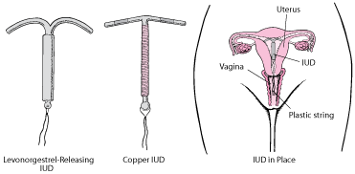
Using the Intra – Uterine Device [IUD]
This is a coil or a loop of plastic.
It is inserted into the uterus by a doctor.

Slide 128
Advantages of IUDs.
It can prevent pregnancy for several years.
It is easy for a health worker to put into the uterus.
Disadvantages of IUDs
It increases the spread of STDs.
The IUDs may block the woman’s tubes causing sterility.
Sometimes it causes excessive pain and bleeding in the uterus.

Slide 129
Using spermicides.
These are jellies or creams that contain chemicals that kill sperms.
They are put in a woman’s vagina before sexual intercourse.
Advantage of spermicides.
They are easy to use.
Disadvantages of spermicides.
They may be hard to get due to lack of money.
They are not readily available in some areas.

Slide 130
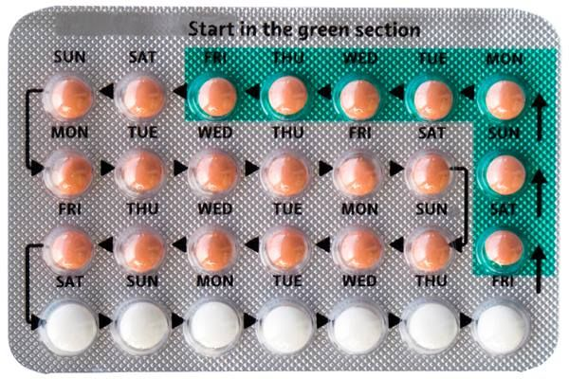
Use of birth control pills. (Contraceptives).
These are tablets which contain hormones that prevent ovulation among women.
One tablet is taken each day.

Slide 131
Advantages of birth control pills.
They are readily available in Uganda.
They are very effective when taken correctly.
Disadvantages of birth control pills.
They are difficult for some women since they are taken every day.
Women with medical problems are not allowed to use them.
They worsen the risk of severe heart attack, cancer and stroke.
The use of birth control pills do not prevent the spread of STD and STIs.

Slide 132
Use of birth control injections.
This is where hormones that prevent ovulation are injected into a woman.
Advantage of birth control injections
It is very effective and convenient for women.
Disadvantages of birth control injections.
It may result into a long delay to become pregnant again.
It may result into permanent sterility in some women.
It causes certain tumours among women.

Slide 133
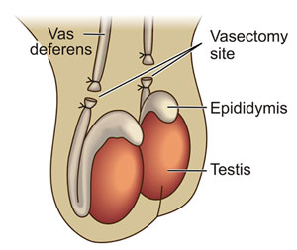
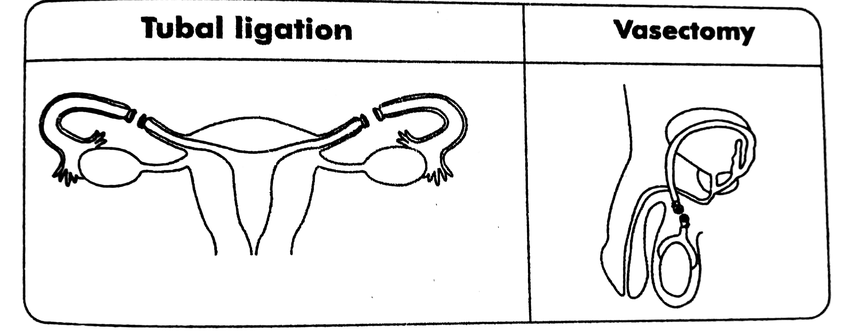
Vasectomy
This is the cutting and blocking of the sperm ducts through surgical operation.
It is only done in males.

Slide 134
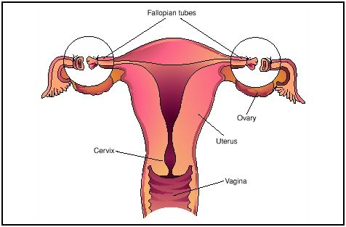
Tubal ligation
This is the cutting and tying of oviducts [fallopian tubes] through surgical operation.

Slide 135
Advantages of Tubal ligation and Vasectomy:
They are 100% effective.
They are convenient and time saving.
Disadvantages of Tubal ligation.
They cause permanent sterility.
They should only be used by people who have had enough children.
They are expensive.

Slide 136
Exercise
1. a) Identify any one artificial chemical method of birth control.
b) State two advantages of the method you have identified in a) above
c) Write any one disadvantage of the method in a) above
2. a) Write S.T.D in full
b) Mention two examples of STDs.
c) Identify any two family planning methods which cannot guard a person against the spread of STDs.
3. a) Briefly explain the following terms as used in family planning
Tubal ligation
Vasectomy
b) Why do you think such methods are not recommended to parents who have not had enough children?
c) Point out any two misconceptions that some parents have for having many children in a family.

Slide 137
PIASCY
Presidential Initiative on AIDS Strategy for Communication to the Youths.
PIASCY is Presidential campaign against the spread of HIV and AIDS among youths.
This involves messages on ways of preventing and controlling the spread of HIV / AIDS infection to Youths like all school going children.

Slide 138
These messages include: -
Say no to sex.
Avoid gifts from strangers.
Respect parent’s advice.
Do not trust anybody for everybody is sick.
Avoid pregnancy as a child.
Avoid bad touches.
Stay in school
Abstain from sex till marriage.
Virginity is healthy.
AIDS kills.
Avoid lonely places.

Slide 139
Importance of PIASCY Messages
They control the spread of AIDS and other STDs.
Promote care for AIDS patients.
Promote AIDS awareness among youths.
Prevent early marriages.
Prevent teenage pregnancy.

Slide 140
Revision Exercise.
1. What is fertilization?
2. What type of fertilization do humans undergo?
3. Where does fertilization take place in humans?
4. Of what importance is reproduction to animals?
5. What name is given to the
a. male gamete
b. female gamete
6. Identify the type of reproduction in human beings.

Slide 141
7. Suggest any one way of keeping the reproductive organs in good health.
8. How are sperms similar to the ova?
9. What is adolescence?
10. What is ovulation?
11. State any two secondary characteristics common in both boys and girls.
12. Give any one primary sex characteristic in boys.
13. Where does implantation take place in females?

Slide 142
14. Write MTCT in full
15. How is MTCT important to the growing embryo?
16. Why do pregnant mothers need food rich in proteins?
17. Which tube supplies food to the growing embryo?
18. Mention any one sign of pregnancy in women
19. How dangerous can teenage pregnancy be to a school girl?

Slide 143
20. Identify any one social factor that may lead to teenage pregnancy.
21. Name any one STD that can be spread through poor hygiene.
22. How best can married partners prevent contracting STDs.
23. What name is given to a couple that has one partner HIV positive and another HIV negative?

